Slide 1
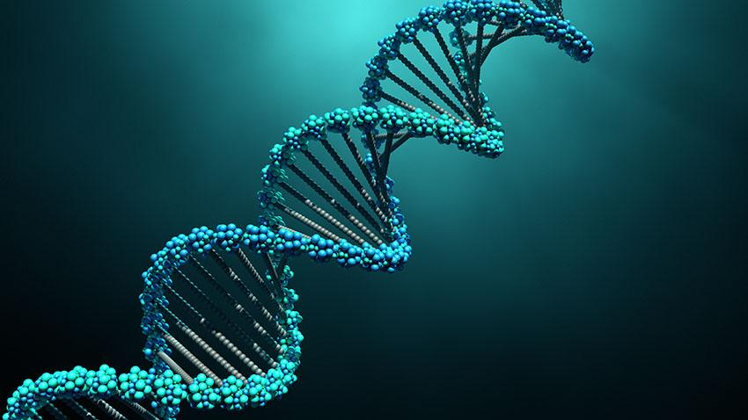
A Study on Benchmark Datasets for Human Disease Genes

Slide 2

Team Members
Mahin Hossain ID : 190204061
MD Shihabul Islam Shovo ID : 190204075
MD Fardin Jaman Aranyak ID : 190204093
Md. Symum Hossain ID : 190204105
Supervised By: Prof. Dr. S. M. A. Al-Mamun

Slide 3

Introduction
Research on Gene Disease Association
Computational Process Field
Curated Datasets
Machine Learning
Contribution toward Standard Datasets

Slide 4

Motivation
Human Genome-Disease Relation
Aid in Developing New Treatment
Vast Research Field
Datasets for Future Work
Helpful For the Society

Slide 5
Literature Review
Gene-Disease-Interconnection
Abnormalities or Mutations
Aspects of Human Health
Inheritance
Secondary Gene Diseases

Slide 6
Literature Review
Computational Tool
Ensembl
OMIM
GWAS Catalog
STRING
VISTA Enhancer Browser
Phenolyzer

Slide 7
Literature Review
Machine Learning Tools
TensorFlow
Keras
Scikit-learn
XGBoost
DeepVariant
Genetic Association Database (GAD)
GeneMANIA

Slide 8
Literature Review
Refereed Paper:
Title: TUDataset: A collection of benchmark datasets for learning with graphs [1]
Graph Classification and Regression
Benchmark Collection Consists of 120 Datasets
All Datasets are Easily Accessible
Comparison of Kernel and Neural Approaches

Slide 9
Literature Review
Refereed Papers:
Title: GCN-MF: Disease-Gene Association Identification By Graph Convolutional Networks and Matrix Factorization [2]
NSSL Approaches have Two Major Limitations :
i) Local-Structure Representation
ii) Unable to Capture Nonlinear Associations
New Framework “GCN-MF” Captures Nonlinear Interactions
Identify Candidate Disease-Gene Links.

Slide 10
Literature Review
Refereed Paper:
Title: Identifying Disease-Gene Associations with Graph-Regularized Manifold Learning [3]
Manifold Learning-Based Method (dgManifold)
Gene Ontology (GO) (Gene Similarity)
Human Phenotype Ontology (HPO) (Disease Similarity)
OMIM Database
Competing Algorithms:
PCFM (Matrix Completion Method)
Katz (Network Based Method)

Slide 11
Literature Review
Refereed Paper:
Title: Recent advances in predicting gene disease association [4]
Genome Variation (GWAS)
Crowdsourcing
Text Mining
Network and semantic similarity-Based Algorithms

Slide 12
Research Gap
Readily usable and reliable datasets are not easy to find
Available datasets claimed to be benchmarked need verification
Reliable huge datasets like OMIM, DisGeNet, etc. need to be standardized for applications
Developing new benchmark datasets also seems worthy

Slide 13
Methodology
Explore & Collect Raw Datasets
Pre-process Data
Build New Standard Dataset
Testing Dataset with Machine Learning Models
Comparison with others Datasets

Slide 14
Datasets
General Datasets that are relevant:
DisGeNet, OMIM, BioPortal
Benchmark Datasets available:
TUDataset
Human Disease Network Dataset

Slide 15
Conclusion & Future Work
Interesting and engaging field
A lot needs to be explored
Future works:
Integrating Multi-OMICS data
Interpretability and visualization
Validation on datasets
Application to precision medicine

Slide 16
References
1. Tudataset: A collection of benchmark datasets for learning with graphs
C Morris, NM Kriege, F Bause, K Kersting… - arXiv preprint arXiv …, 2020 - arxiv.org
2.GCN-MF: disease-gene association identification by graph convolutional networks and matrix factorization
P Han, P Yang, P Zhao, S Shang, Y Liu… - Proceedings of the 25th …, 2019 - dl.acm.org
3.Identifying disease-gene associations with graph-regularized manifold learning
P Luo, Q Xiao, PJ Wei, B Liao, FX Wu - Frontiers in genetics, 2019 - frontiersin.org
4. Recent advances in predicting gene–disease associations
K Opap, N Mulder - F1000Research, 2017 - ncbi.nlm.nih.gov

